Slide 1


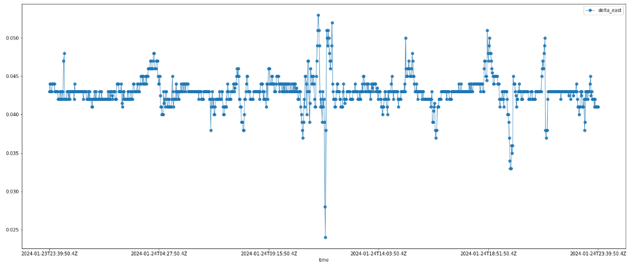






Distributed System and Big Data – A.A. 2023/24 - Unict
Schema progetto (prima parte) di Francesco Pandolfo
VPN
User Interface
get-time-series
8001
8080 /gettimeseries
/query
createQuery_Influxdb
dataframe
JsonRawToJsonDataFrame
8086
/query
users-manager
JSON raw
8002
8080 /consumers
/register
/getall
/{username}
3306
- consumers
- subscriptions
/subscriptions
/register
/getall
/unsubscribe
30sec
processSubscriptions
publish
9092
kafka
notifier
topics:
- station-threshold-mintime
- usersmanager_LOG
- notifier_LOG
subscribeTopics
subscribe
10sec
checkNewSubscriptions
station-threshold-mintime
emailService

Slide 2

Distributed System and Big Data – A.A. 2023/24 - Unict
Schema progetto (prima parte) di Francesco Pandolfo
VPN
User Interface
get-time-series
8001
8080 /gettimeseries
/query
createQuery_Influxdb
custom exporter
JsonRawToJsonDataFrame
dataframe
8086
get-time-series:
- query_time_seconds_max{class="dsbd.gettimeseries.api.TimeSeriesController", instance="gettimeseries:8080", method="query"}
users-manager:
- SubscriptionsService_seconds_max{instance="usersmanager:8080", job="prometheus", method="processSubscriptions"}
- SubscriptionsService_seconds_count{instance="usersmanager:8080", job="prometheus", method="exceptionManager"}
kafka:
- avg by (instance,mode) (irate(process_cpu_seconds_total{mode!='idle', job="kafka"}[1m]))
/query
users-manager
JSON raw
8002
8080 /consumers
/register
/getall
/{username}
3306
- consumers
- subscriptions
/subscriptions
/register
/getall
/unsubscribe
30sec
processSubscriptions
publish
custom exporter
9092
kafka
notifier
topics:
- station-threshold-mintime
- usersmanager_LOG
- notifier_LOG
cAdvisor
subscribeTopics
subscribe
10sec
checkNewSubscriptions
station-threshold-mintime
emailService

Slide 3
Distributed System and Big Data – A.A. 2023/24 - Unict
Schema progetto (prima parte) di Francesco Pandolfo
VPN
User Interface
get-time-series
8001
8080 /gettimeseries
/query
createQuery_Influxdb
dataframe
JsonRawToJsonDataFrame
8086
/query
users-manager
JSON raw
8002
8080 /consumers
/register
/getall
/{username}
3306
- consumers
- subscriptions
/subscriptions
/register
/getall
/unsubscribe
30sec
processSubscriptions
publish
9092
kafka
notifier
topics:
- station-threshold-mintime
- usersmanager_LOG
- notifier_LOG
subscribeTopics
subscribe
10sec
checkNewSubscriptions
station-threshold-mintime
emailService

